Slide 1
Principles of Data Science
Li Niu

Slide 2




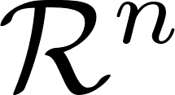


Eigen Decomposition
eigen value
eigen vector
For ,
The set of all eigenvectors of together with the zero vector
forms a subspace of
This set is closed under vector addition and scalar multiplication.

Slide 3

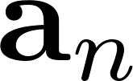
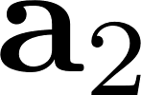
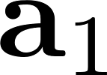


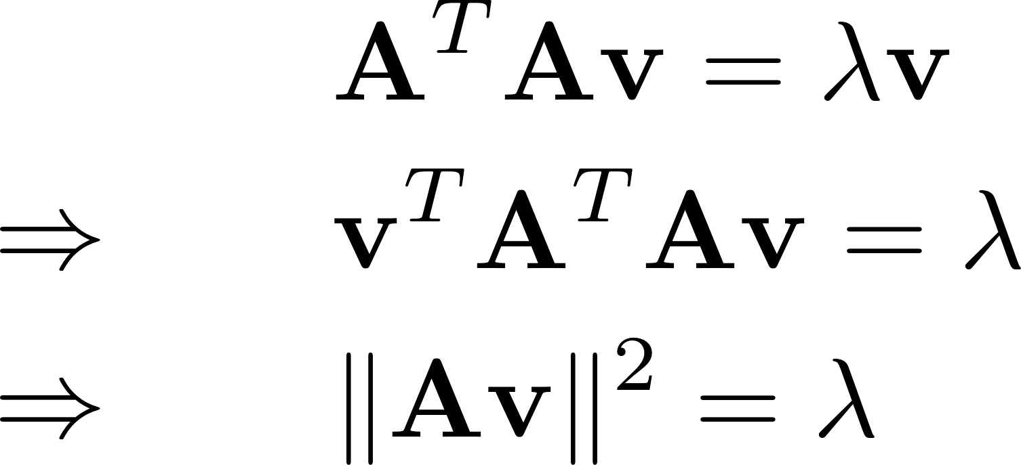



Relation to SVD
….
: distance
: projection
Recall that singular value , so

Slide 4
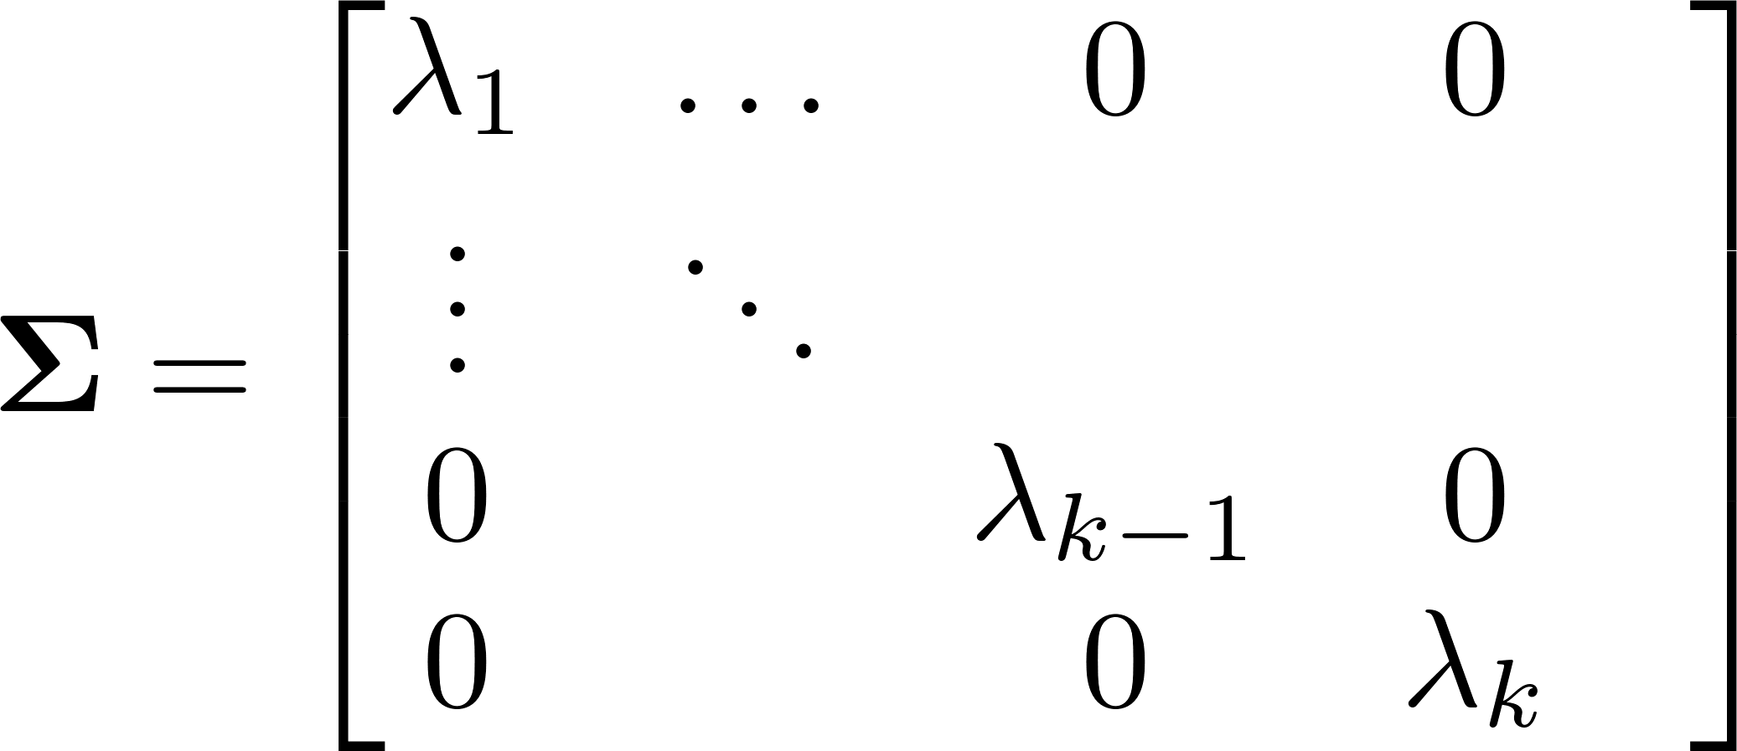






Relation to SVD
We denote
If is real symmetric matrix

Slide 5


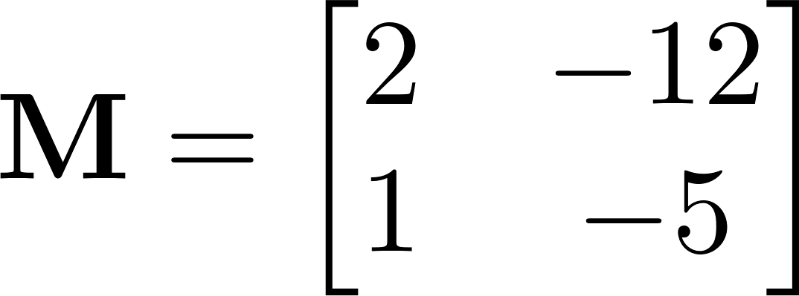


Eigen Decomposition
Solving eigenvalues and eigenvectors of
has nonzero solutions for iff
singular matrix

Slide 6

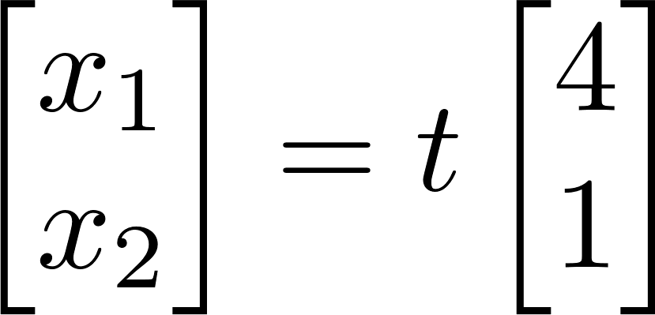

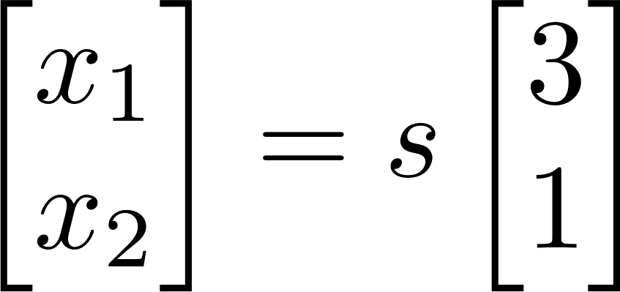
Eigen Decomposition
Solving eigenvalues and eigenvectors of

Slide 7
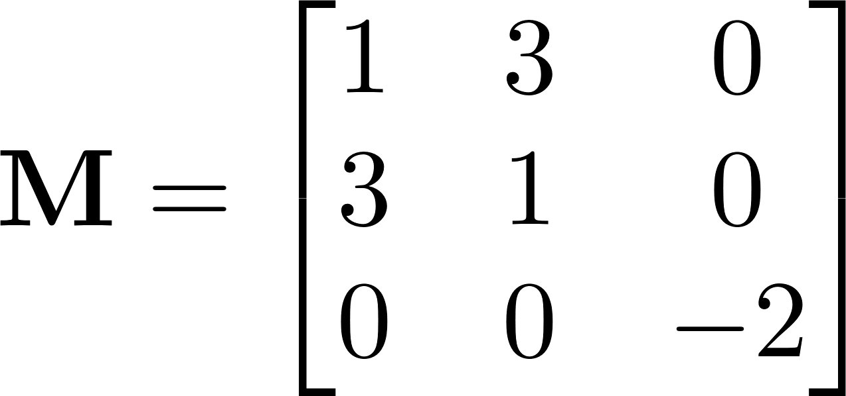
Question
Eigen values and eigen vectors of the following matrix:

Slide 8



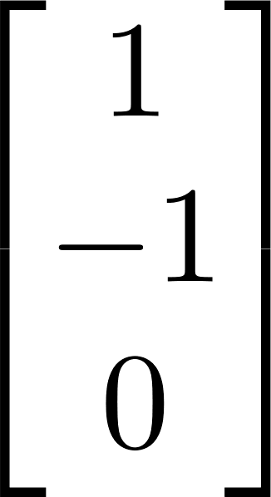


Answer
or

Slide 9


Eigen Decomposition
Important properties:

Slide 10

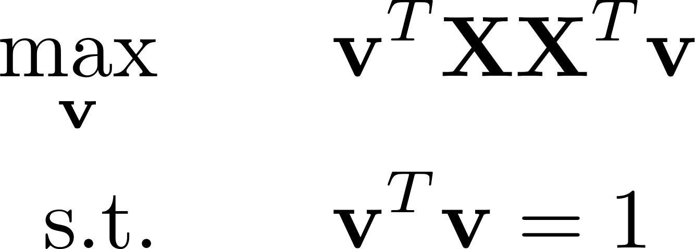


Application 1: Principle Component Analysis
Maximum variance direction: when is decentralized
Lagrangian form:
Eigen decomposition

Slide 11
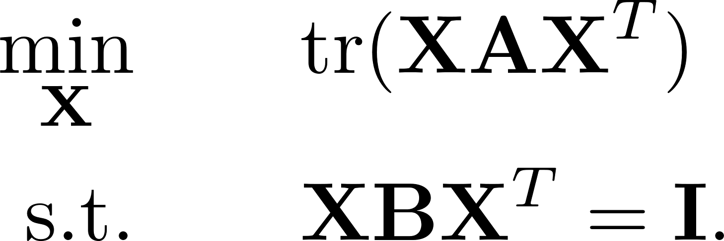

Application 2: Transfer Component Analysis
Introduce Lagrangian multipliers, i.e., a symmetric matrix

Slide 12




Application 2: Transfer Component Analysis
Eigen decomposition on

Slide 13
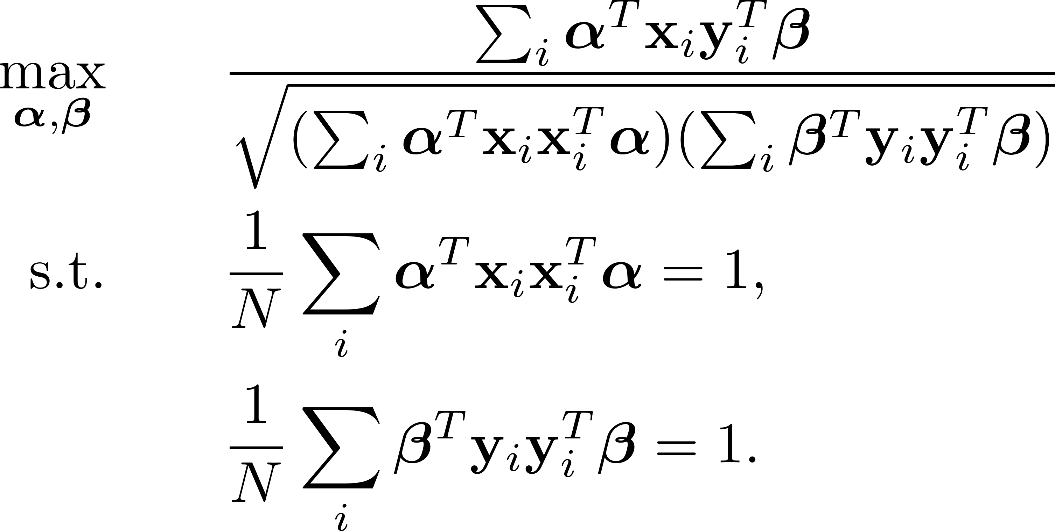
Application 3: Canonical Correlation Analysis

Slide 14




Application 3: Canonical Correlation Analysis
It can be proved that

Slide 15
Thanks!

